Slide 1
Introduction to Software Design
Chapter 1

Slide 2
Chapter Objectives
To become familiar with the software challenge and the software life cycle
To understand what activities take place in each phase of the software life cycle
To learn how to use top-down design and object-oriented design
To learn to use data abstraction, procedural abstraction, and information hiding to manage complexity
To learn how to draw class diagrams to document the interaction between classes

Slide 3
Chapter Objectives (continued)
To learn the role of abstract data types in building models of computer systems and how to implement them using classes and interfaces
To become familiar with use cases as a tool to document a system’s interaction with the user
To understand the software design process by following the design and implementation of an array-based telephone directory
To become familiar with sequence diagrams as a tool for documenting the interaction between multiple classes used in a program

Slide 4
The Software Challenge
In industry, a software product is expected to be used for an extended period of time by someone who did not write the program and who is not intimately familiar with its internal design
Initial specification for a software product may be incomplete
Specification is clarified through extensive interaction between users of the software and the system analyst
A requirements specification should be generated at the beginning of any software project
Designers and users should both approve the document

Slide 5
The Software Life Cycle
Software products go through several stages as they mature from initial concept to finished product
The sequence of stages is called a life cycle
It is important to design and document software in an organized way so that it can be easily understood and maintained after the initial release
The person who maintains the software is not necessarily the person who writes it

Slide 6
Software Life Cycle Models
Waterfall model: simplest way of organizing activities that transform software from one stage to another
Activities are performed in sequence and the results of one flows into the next
Waterfall model is simple but unworkable
  Fundamental flaw is assumption that each stage can and must be completed before the next one occurs
Sometimes, it is not until the product is finished that the user can fully express his or her requirements

Slide 7
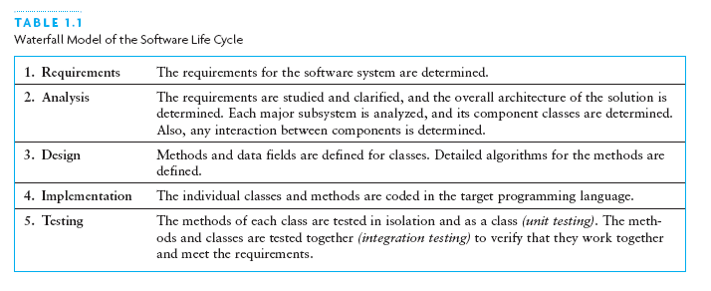
Waterfall Model

Slide 8
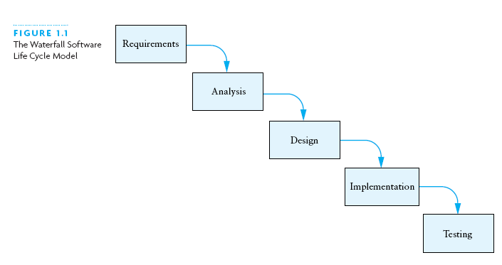
Waterfall Model (continued)

Slide 9
Software Life Cycle Models (continued)
Common themes among alternative models is to develop software product in stages or cycles
Unified Model: the cycles are called phases and iterations and the activities are called workflows
Four phases
  Inception
  Elaboration
  Construction
  Transition

Slide 10
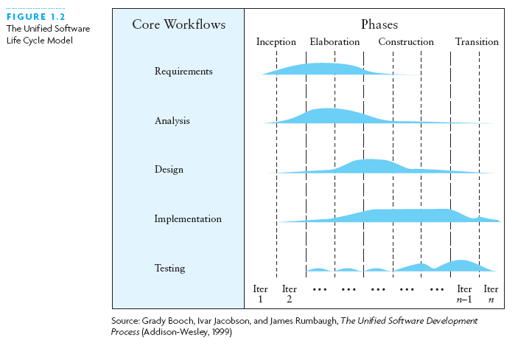
Software Life Cycle Models (continued)

Slide 11
Software Life Cycle Activities (continued)
Certain activities are essential for software development
  Requirements specification
  Architectural, component, and detailed designs
  Implementation
  Unit, integration, and acceptance tests
  Installation and maintenance

Slide 12
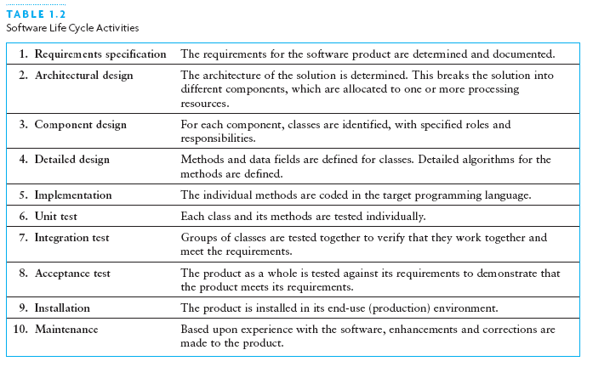
Software Life Cycle Activities

Slide 13
Software Life Cycle Activities (continued)
Requirements Specification
  System analyst works with software users to clarify the detailed system requirements
  Questions include format of input data, desired form of any output screens, and data validation
Analysis
  Make sure you completely understand the problem before starting the design or program a solution
  Evaluate different approaches to the design

Slide 14
Software Life Cycle Activities (continued)
Design
  Top-down approach: breaking a system into a set of smaller subsystems
  Object-oriented approach: identification of a set of objects and specification of their interactions
  UML diagrams are a design tool to illustrate the interactions between
    Classes
    Classes and external entities

Slide 15
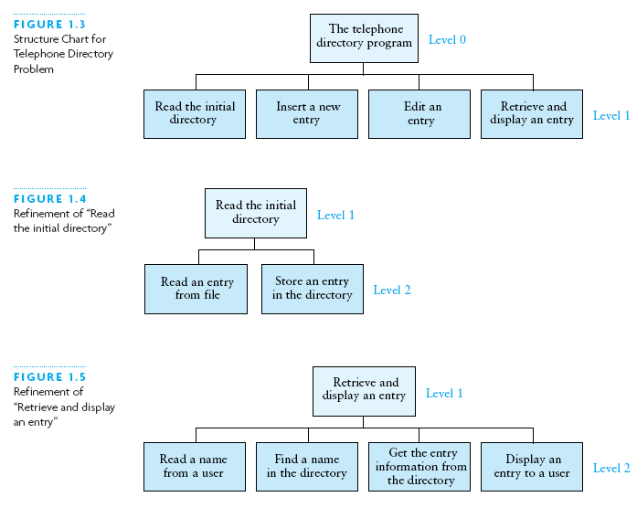
Software Life Cycle Activities (continued)

Slide 16
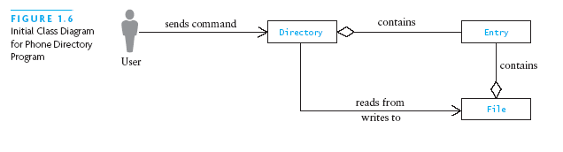
Software Life Cycle Activities (continued)

Slide 17
Using Abstraction to Manage Complexity
An abstraction is a model of a physical entity or activity
Abstraction helps programmers deal with complex issues in a piecemeal fashion
Procedural abstraction: distinguish what is to be achieved by a procedure from its implementation
Data abstraction: specify the data objects for a problem and the operations to be performed on them without concern for their representation in memory

Slide 18
Using Abstraction to Manage Complexity (continued)
If a higher-level class references a data object only through its methods, the higher-level class will not have to be rewritten, even if the data representation changes
Information hiding: Concealing the details of a class implementation from users of the class

Slide 19
Abstract Data Types, Interfaces, and Pre- and Postconditions
A major goal of software engineering is to write reusable code
Abstract data type (ADT): The combination of data together with its methods
A Java interface is a way to specify an ADT
  The interface specifies the names, parameters, and return values of the ADT methods without specifying how the methods perform their operations and without specifying how the data is internally represented
Each class that implements an interface must provide the definitions of all methods declared in the interface

Slide 20
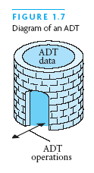
Abstract Data Types, Interfaces, and Pre- and Postconditions (continued)

Slide 21
Abstract Data Types, Interfaces, and Pre- and Postconditions (continued)
You cannot instantiate an interface
You can declare a variable that has an interface type and use it to reference an actual object
A Java interface is a contract between the interface designer and the programmer who codes a class that implements the interface
Precondition: a statement of any assumptions or constraints on the method data before the method begins execution
Postcondition: a statement that describes the result of executing a method

Slide 22
Requirements Analysis, Use Cases, and Sequence Diagrams
First step in analysis is to study the problem of input and output requirements carefully to make sure they are understood and make sense
Use case: list of the user actions and system responses for a particular sub-problem in the order that they are likely to occur
Sequence diagram: shows all the objects involved in this use case across the horizontal axis, time is shown along the vertical axis

Slide 23
Design of an Array-Based Phone Directory
Case study deals with design, implementation, and testing of the software-based phone directory
In UML class diagrams
  + sign next to a method or attribute means it is public
  - sign next to a method or attribute means it is private
Classes to design include:
    PDUserInterface
    PDApplication
    PhoneDirectory
    ArrayBasedPD
    DirectoryEntry

Slide 24
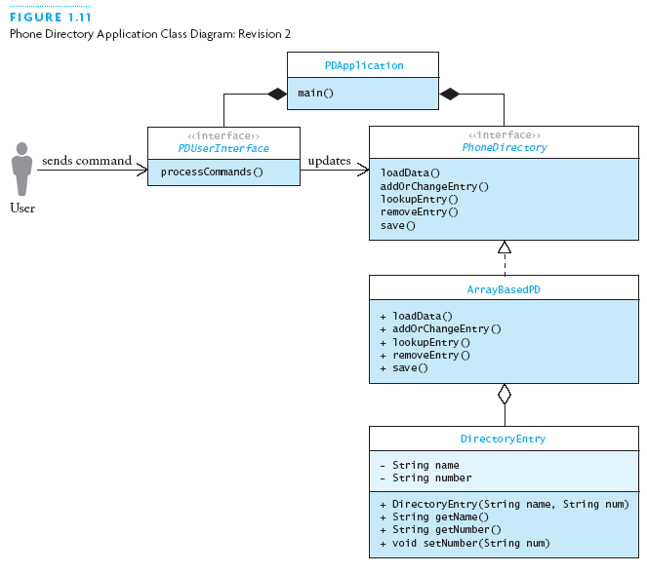
Design of an Array-Based Phone Directory (continued)

Slide 25
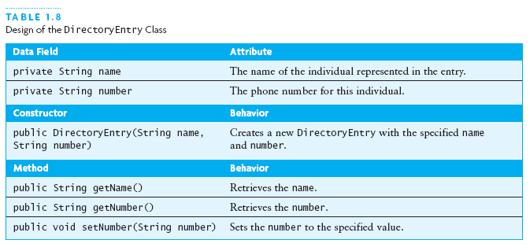
Design of an Array-Based Phone Directory (continued)

Slide 26
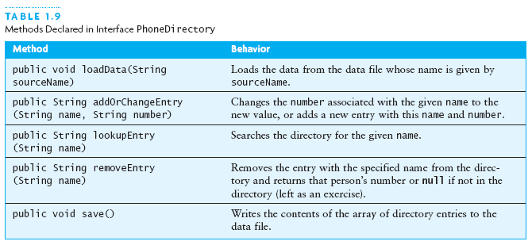
Design of an Array-Based Phone Directory (continued)

Slide 27
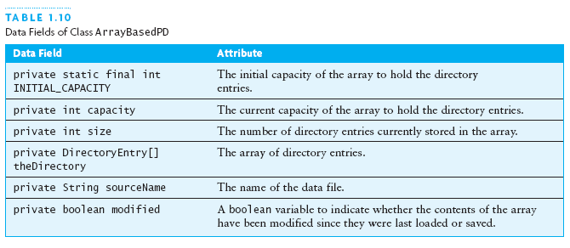
Design of an Array-Based Phone Directory (continued)

Slide 28
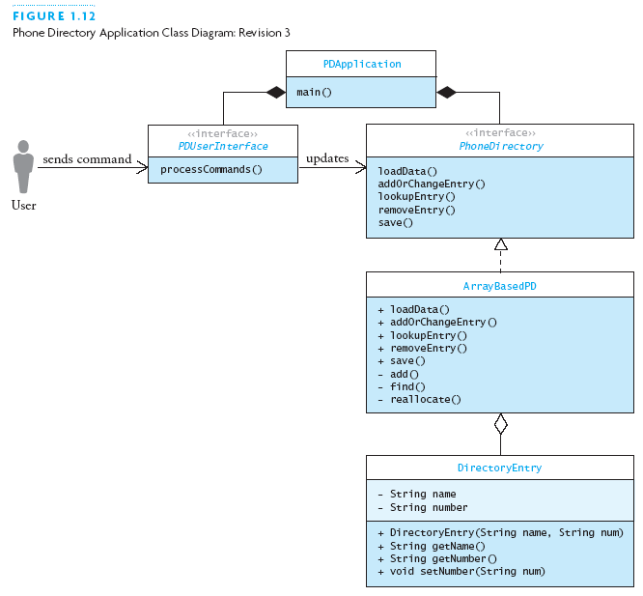
Design of an Array-Based Phone Directory (continued)

Slide 29
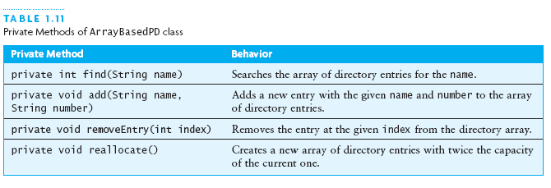
Implementing and Testing the Array-Based Phone Directory

Slide 30
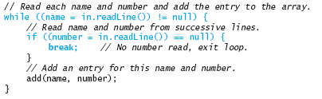
Implementing and Testing the Array-Based Phone Directory (continued)
Note that some code in this application is controversial
  Combination of assignment with the evaluation of a condition
  Break statement allows exiting of the while loop without storing an entry

Slide 31
Chapter Review
Inheritance and class hierarchies mean that one class can be a refinement or extension of another
Encapsulation and inheritance impose structure on object abstractions
Polymorphism captures the idea that methods may take on a variety of forms to suit different purposes
The keyword interface defines an interface
A class that realizes (implements) an interface defines the methods that the interface declares

Slide 32
Chapter Review (continued)
The keyword abstract defines an abstract class or method
Delegation gains some of the advantages of multiple inheritance
Visibility is influenced by the package in which a class is declared

